Slide 1

Power BI Git-ting CI/CD
Kristyna Ferris
Feel free to grab some swag up front! Stickers, pens, pins, and coasters available!

Slide 2

About Me ~ Kristyna Ferris
Microsoft MVP, Data Platform & Fabric Solution Architect, P3 Adaptive Lexington Data Tech Group co-organizer Co-author on DataOnWheels Co-founder of Data On Rails
Blog - https://dataonwheels.wordpress.com/ LinkedIn - https://www.linkedin.com/in/kristyna-ferris-dataonwheels/
Twitter - @data_dragoness

Slide 3



ALS Walk Next Week – Join our Team!

Slide 4
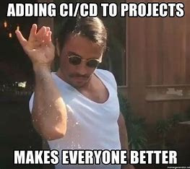
What is Git?
Source control management
Enables collaboration
Captures version history
Continuous integration and continuous development (CI/CD)

Slide 5
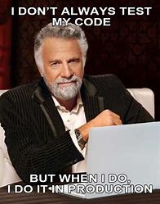
Why do we need CI/CD?
CI/CD stands for continual integration and continual development
Report design is never done, as the business changes and evolves so should the reporting
But do we really need to do all this? I mean I tested enough before I published the report

Slide 6
Why do we need CI/CD?
Unfortunately, nobody is perfect
Stakeholders change their minds
The power of CI/CD lies within the ability to make a copy of your code (or report) to develop and test against while your stakeholders interact with the current version
Using git also enables multiple developers to work on the same project at the same time

Slide 7
Useful Git Commands & Definitions
Commands
Sync = performs a pull from your remote branch and a push to the same remote branch
Pull = grabs any new items or changes that have been made to a selected branch and adds them to your branch
Push = adds new items or changes from your local branch to the selected remote branch
Fetch = grabs new items and changes from a selected branch and shows them to you. Does not merge these into your branch unless you specify
Checkout = creates a new branch based on a specified branch
Stage = select what changes you would like to apply to main
Commit = send staged changes up to the remote branch
Definitions
Git = a development operations (devops) tool used for source code management that allows developers to work together on different pieces of the same project
Branch = copy of code where individuals make changes and run tests against code
Main = the copy/branch of code that is live in production
Pull Request = process for peer review before code is merged back to the main branch
Merge = grabs all the pieces of code from the branch and adds them to main
Conflict = occurs commonly when changes are made in a branch to a file that was deleted from main or changed from a different branch

Slide 8


Slide 9
Useful Git Commands & Definitions
Pull = grabs any new items or changes that have been made to a selected branch and adds them to your branch
Push = adds new items or changes from your local branch to the selected remote branch
Checkout = creates a new branch based on a specified branch
Stage = select what changes you would like to apply to main
Branch = copy of code where individuals make changes and run tests against code
Pull Request = process for peer review before code is merged back to the main branch
Merge = grabs all the pieces of code from the branch and adds them to main

Slide 10
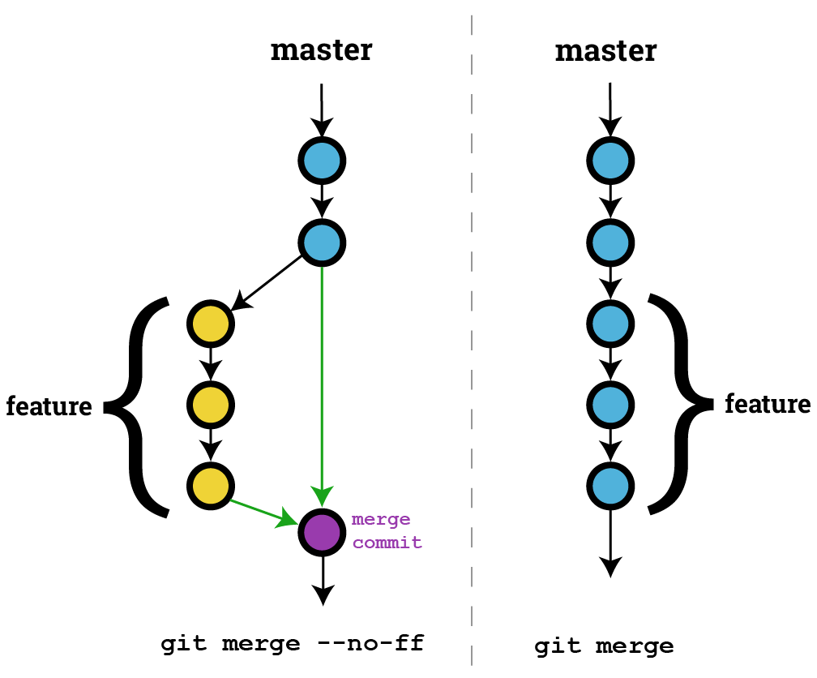

Let’s Git Metaphorical

Slide 11
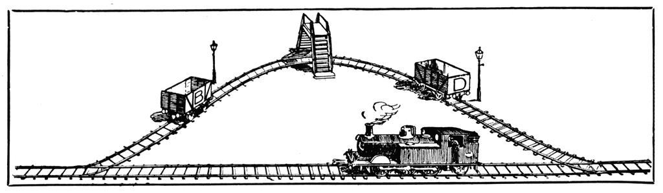
Git Station
Pull Push Sync
Stage
Commit
New Branch
Pull Request
Checkout
Merge
Main
File Copy
Command
Stop Point

Slide 12

Prerequisites
Option 1 (Fabric/Premium only):
Git-enabled workspaces within a Power BI pipeline
Option 2 (Premium Per User):
Power BI pipeline and repository
Option 3 (Pro or E5):
Repository and screenshare code reviews

Slide 13
PBI License & Git Matrix
 | Free | Pro / E5 | Premium Per User | Fabric Capacity
Create .pbip file | X | X | X | X
Publish .pbix file |  | X | X | X
Create DevOps Repo | X* | X* | X* | X*
Use Git Operations | X* | X* | X* | X*
Use Fabric Deployment Pipelines |  |  | X | X
Use Git Integrated Workspaces |  |  | X | X

Slide 14
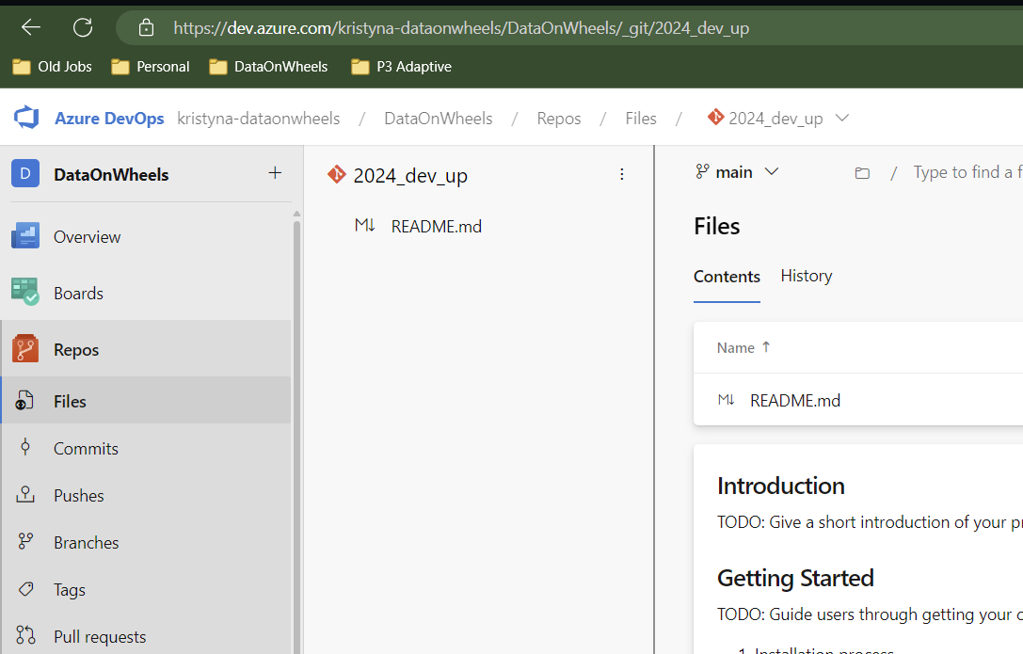
Create an Azure Repo
www.dev.azure.com
Lots of strategic repo structure options
When in doubt, keep it as simple as possible and as complicated as necessary

Slide 15
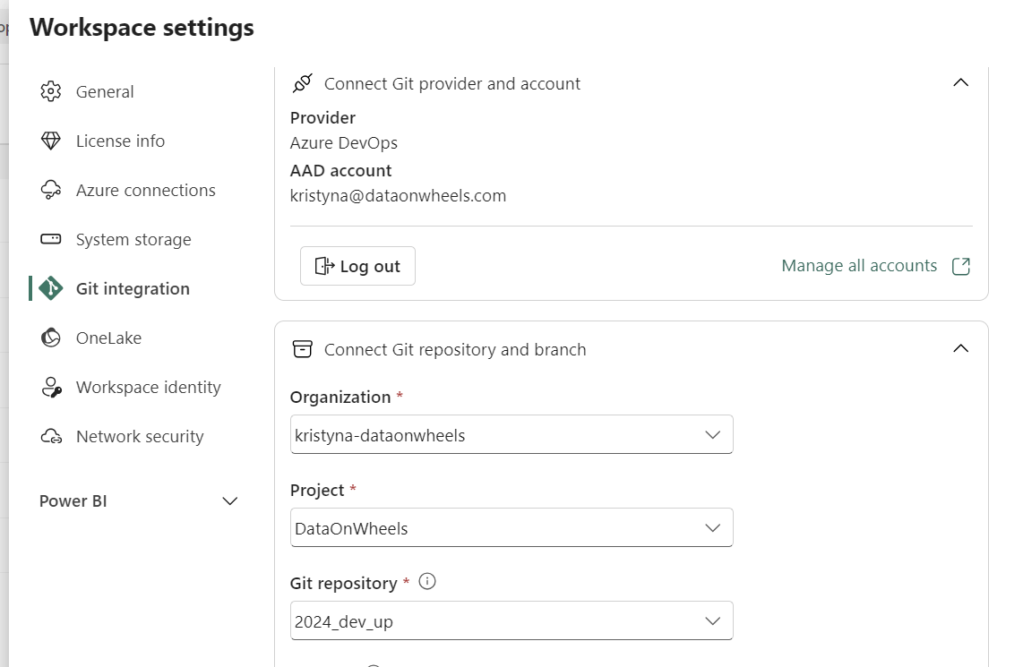
Connect Workspace to Repo
Only workspace admins can connect to a repository
It will automatically sync the contents of your workspace to the repo

Slide 16
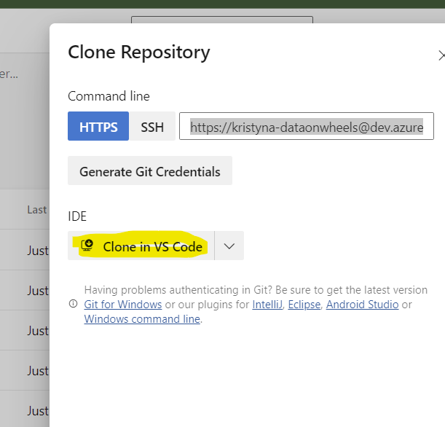
Clone the Repository
Allows us to access contents of the repo on our local machine and make changes

Slide 17
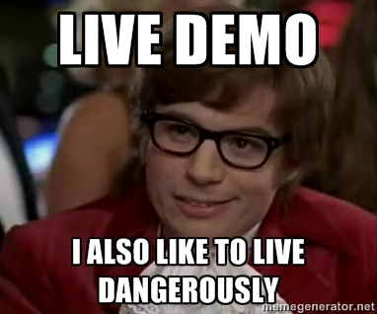

Slide 18
Power BI Git-ting CI/CD: Part 2
Kristyna Ferris

Slide 19
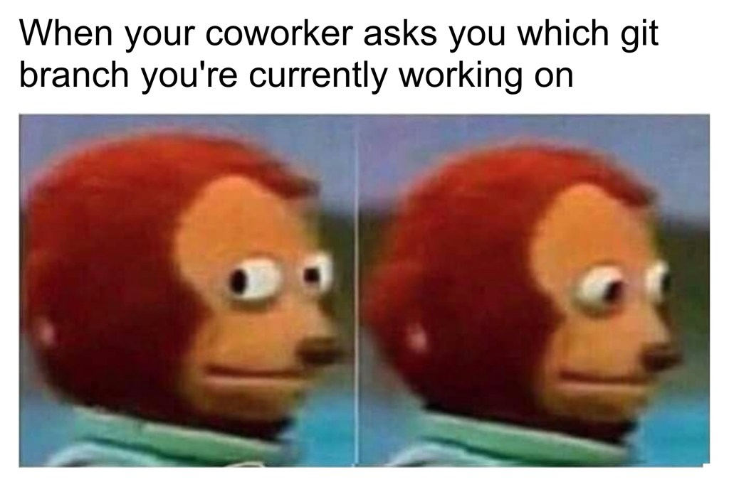
Workflow – Feature Branches
There are lots of ways to work with git branches, I recommend creating feature branches to do your work then merge to dev when you’re ready for it to be productionalized
When it’s time to productionalize, we will utilize Pull Requests (aka PRs) to merge into development workspace.

Slide 20
Feature Branch Operations
Pull Push Sync
Stage
Commit
New Branch
Pull Request
Checkout
Merge
Main
File Copy
Command
Stop Point

Slide 21
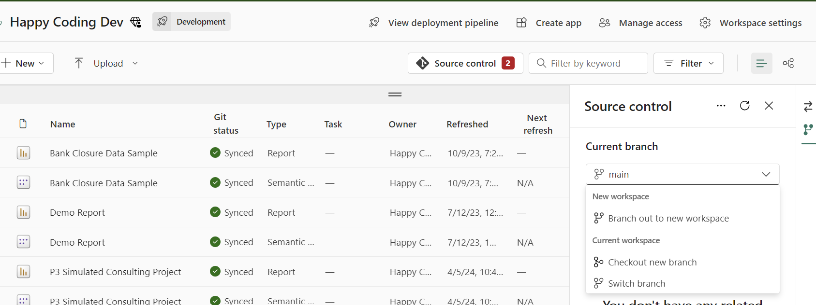
Create a Branch (repo & workspace)

Slide 22


Slide 23
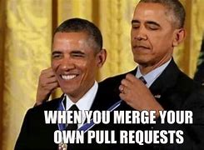
Do I really NEED PRs?
PR = short-hand for Pull Request
PRs allow for a final approval round before merging your code back into the main branch
Allows for better coding standard maintenance and accountability

Slide 24
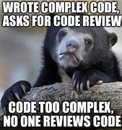
PR Etiquette
Make sure your code uses clear variables and naming conventions
Commit often and write clear commit messages
Put notes into your code to help future you and current reviewers

Slide 25

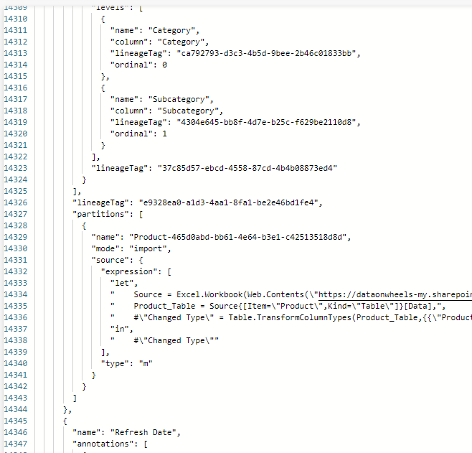
Reviewing PBIP PRs

Slide 26

Use PBI Service
DevOps isn’t quite the tool we are looking for
Power BI pipelines can offer us a better way to review visual changes to a report
We can use JSON and DevOps to quickly identify what has changed, even if we can’t visualize it
Add notes into the PR itself to help the review process

Slide 27
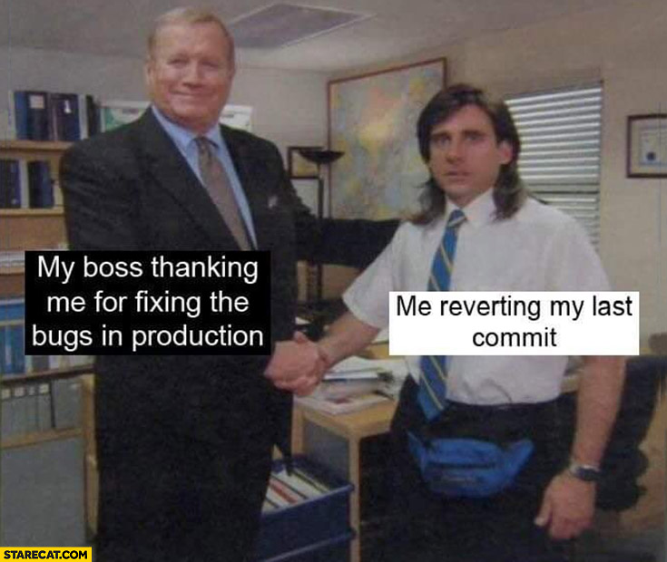
Revert – The Secret Sauce of Git
This is why having clear commit messages and small amounts of changes in each commit matters
Revert = undo all the changes within a commit and create a new commit. This can be done from any commit, not just the last change applied.
There are more options that can be used in a traditional development environment, but this is the easiest to use within DevOps

Slide 28

Questions?

Slide 29

Don’t forget to connect, thanks for listening!
https://dataonwheels.wordpress.com/
kristyna@dataonwheels.com
@data_dragoness
GitHub

